Slide 1
COMP 3400
Week 12 – Friday

Slide 2
Last time
What did we talk about last time?
Readers-writers problem
Search-insert-delete problem
Dining philosophers

Slide 3
Questions?

Slide 4
Project 3

Slide 5
Assignment 7
Form teams!

Slide 6
Distributed Computing

Slide 7
Distributed computing
The Internet has existed for a long time, but it's been transformed since 2000 by the power of distributed computing
Commercial examples:
Google's search, app, and storage technologies
Facebook, which has more than 3.07 billion active users per month
Amazon Web Services, providing access to distributed computing that can scale based on demand
Blockchain technologies
Crowd-sourced computing:
BOINC, a platform for home computers to work on big problems, like SETI@home
Folding@home, a platform for studying the computationally hard problem of protein folding
Great Internet Mersenne Prime Search, searching for large prime numbers, currently holding the record for the largest prime with 41,024,320 digits

Slide 8
Parallelism vs. concurrency
Although a lot of computation involves both parallelism and concurrency, they're two different things
Concurrency means that tasks can interact with each other
Parallelism means that two tasks are running at the same time
You can have concurrency without parallelism
Example: A multi-threaded program on a single-core system, which can still have race conditions
You can have parallelism without concurrency
Example: Programs running on separate cores or processors that are computing part of a larger answer without coordination

Slide 9
Kinds of parallel systems
Core 1
Core 2
Modern desktop and laptop CPUs are almost all multicore, meaning that they have separate cores capable of executing instructions independently
Dual core example on the right
Symmetric multiprocessing (SMP) computers have many processors connected to the same memory
A model popular for older supercomputers
Clusters use several machines connected on a network
L3 Cache (Unified)
L2 Cache (Unified)
L1 Cache (Instruction)
L1 Cache (Data)
L2 Cache (Unified)
L1 Cache (Instruction)
Control Unit
Arithmetic and Logic Unit
Control Unit
L1 Cache (Data)
Arithmetic and Logic Unit

Slide 10
Parallel Design Patterns

Slide 11
Parallel design patterns
Concurrency is required for many systems to work and has many goals
Parallel processing, however, is usually focused on getting work done faster
To do this, parallel design patterns often work at two levels:
Algorithmic strategy patterns that break down a problem in a way that can be computed by multiple processors
Implementation strategy patterns for coding up parallel execution

Slide 12
Task parallelism and data parallelism
There are two fundamental kinds of parallelism that are possible
Task parallelism
Breaking up a problem into subtasks that can be run in parallel
Example: Alice cooks dinner, Bob cleans the house, and Catherine gets vengeance on their enemies
Data parallelism
Doing the same tasks in parallel but on different data
Alice, Bob, and Catherine each chop up 1/3 of the total amount of carrots for a soup

Slide 13
Embarrassingly parallel
The easiest kind of problems to parallelize are called embarrassingly parallel
Maybe there are many unrelated tasks that all need to get done
Maybe there's lots of data to process, and no coordination is necessary to process it
The following code shows an embarrassingly parallel problem, since initializing the array could easily be divided up among many tasks
for (int i = 0; i < 100000000; ++i)
array[i] = i * i;

Slide 14
Divide-and-conquer
Algorithms themselves can suggest approaches for parallelism
Divide-and-conquer algorithms divide problems into parts, find answers for the sub-problems, and then combine those answers into an overall solution
Quicksort partitions into two subarrays and then recursively sorts
Merge sort also divides and recursively sorts
As discussed in COMP 4500, many important algorithms have a divide-and-conquer shape, and it's often possible to let each divided task be handled by a separate thread

Slide 15
Pipelines
The idea of a pipeline is to divide a task into independent steps, each of which can be performed by dedicated hardware or software
Example RISC pipeline:
Instruction fetch
Decode
Execute
Memory Access
Writeback

Slide 16
Pipeline performance
Consider a TV show with the following tasks:
Write
Rewrite
Film
Edit
Assume each task takes 1 week
How much total time does it take to produce a 13 episode season with no pipelining?
How much time does it take if we can pipeline stages with fully independent teams for each stage?
Note that a pipeline's speed is limited by its slowest stage, the bottleneck
Each stage of a pipeline can be executed by a separate thread
If you have an n stage pipeline, what's the maximum speedup you can get?

Slide 17
Implementation strategy patterns
After deciding on the algorithmic strategy pattern, it's necessary to turn it into code
Several implementation strategy patterns are common:
Fork/join
Map/reduce
Manager/worker

Slide 18
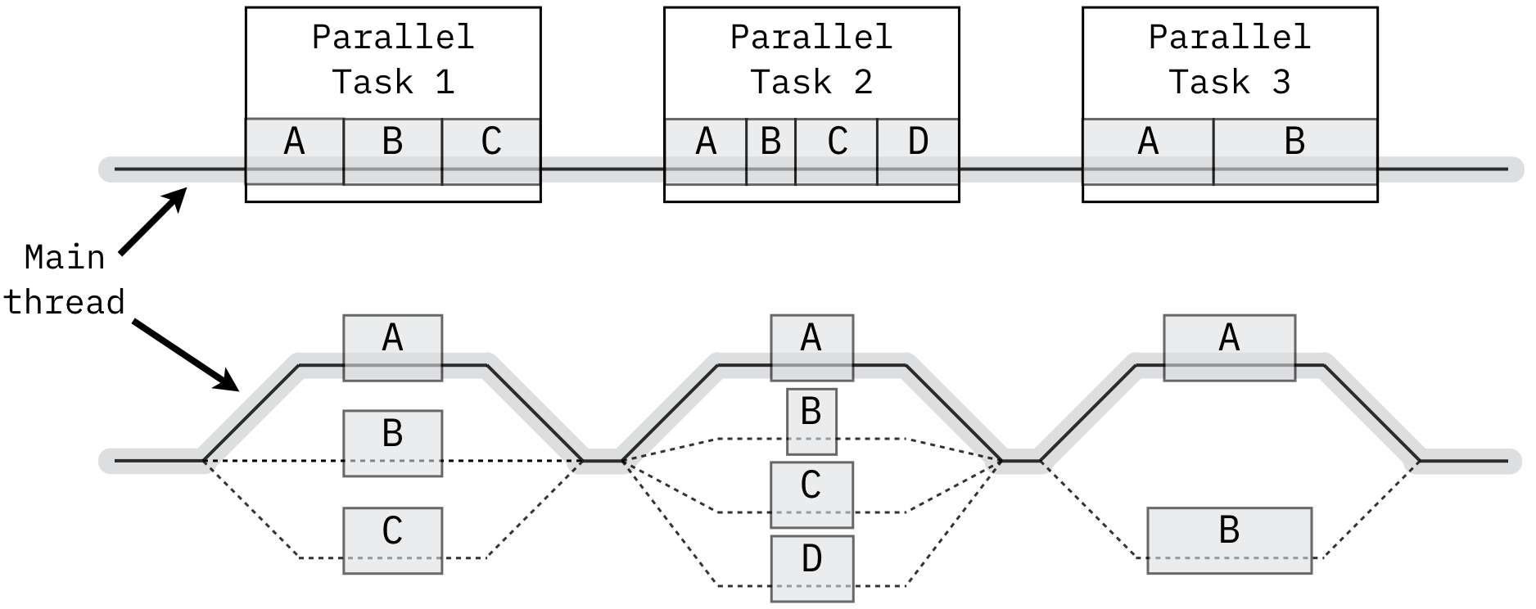
Fork/join
The fork/join pattern uses a main thread that spawns additional threads when there are parallel tasks to be done
After those tasks complete, the main thread joins the spawned threads
A fork/join pattern could be used for either task parallelization or data parallelization

Slide 19
Fork/join in code
The following code shows the fork part of a fork/join pattern where a thread is created to do some of the work of initializing a large array
The OpenMP library contains macros to divide a loop between threads automatically, turning the following code into the previous
for (int i = 0; i < 10; ++i) // Make 10 threads
{
args[i].array = array;
args[i].start = i * 10000000;
pthread_create (&threads[i], NULL, multiply, &args[i]);
}
#pragma omp parallel for
for (int i = 0; i < 100000000; ++i)
array[i] = i * i;

Slide 20
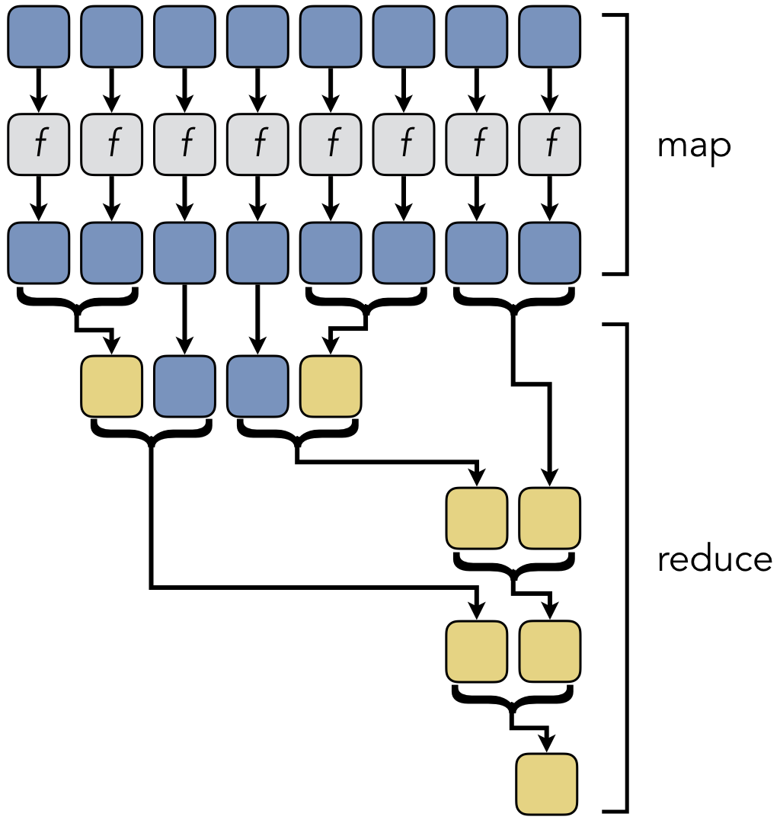
Map/reduce
Map/reduce is similar to fork/join
The biggest difference is a philosophical one about how the work is described
Map/reduce has two stages:
Map applies a function to each piece of input data
Reduce combines the results to get a final answer
Map/reduce is commonly used on clusters and distributed systems
The open source Apache Hadoop is a popular tool for map/reduce computing

Slide 21
Manager/worker
The manager/worker thread pattern is commonly used with task parallelism
Independent tasks are given to work threads that communicate with a central management thread
Event handling, for example, can be viewed as manager/worker
Workers can also wait for a data value to change from NULL, as in the code below
void * worker (struct args * _args)
{
struct args *args = (struct args *) _args;
pthread_mutex_lock (args->lock);
while (true)
{
while (args->data == NULL) // Wait for data
pthread_cond_wait (args->data_received, args->lock);
if (! args->running) pthread_exit (NULL);
// Process data
}
}

Slide 22
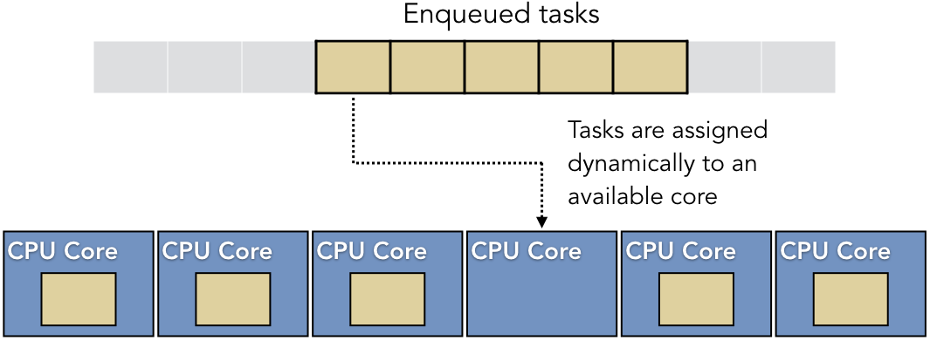
Parallel execution patterns
There are additional decisions to be made beyond the algorithmic strategy pattern and the implementation strategy pattern
How threads are mapped onto hardware is another issue
Rather than worrying about creating too many threads initially or dynamically creating threads, one approach is a thread pool
A thread pool is a fixed number of threads with a queue of tasks
When a thread finishes its work, it can dequeue a new task

Slide 23
Thread pools
Thread pool advantages:
The cost of creating threads is only paid once
Resource consumption is more predictable because there won't suddenly be a lot more threads
Each thread self-manages the load by getting more work when it finishes
Thread pool disadvantages:
Cache performance can be poor because there's no coordination between which thread is doing what
Crashes and errors can be hard to recover from since we won't know which thread was doing the thing that failed
Managing the task queue requires synchronization that could slow things down

Slide 24
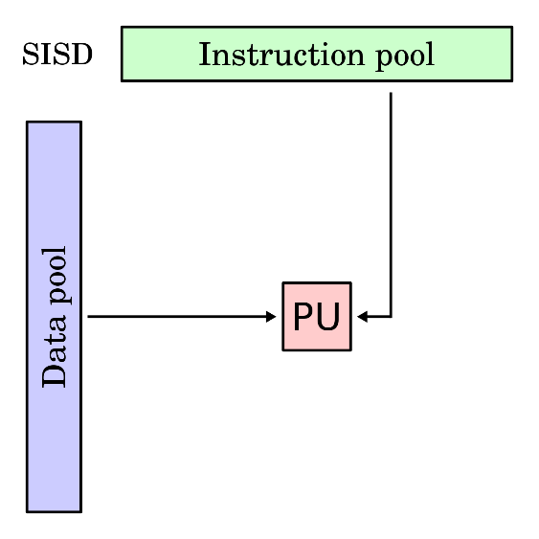
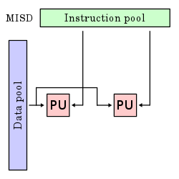
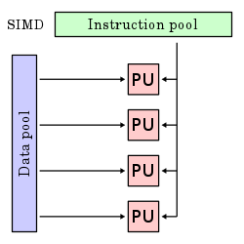
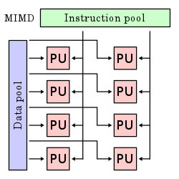
Flynn's taxonomy
Flynn's taxonomy divides hardware into how they can deal with multiple instructions and multiple pieces of data
Single Instruction Single Data (SISD) is sequential processing of one piece of data with one instruction
Single Instruction Multiple Data (SIMD) is processing several pieces of data with the same instruction, like the vector processing done in graphics cards
Multiple Instruction Single Data (MISD) isn't used commonly, but it can allow for fault-tolerance because different instructions are executed in parallel on the same data
Multiple Instruction Multiple Data (MIMD) is processing different instructions on different data at the same time
Images from Wikipedia

Slide 25
Upcoming

Slide 26
Next time…
Limits of parallelism
Timing in distributed environments
Reliable data storage and location

Slide 27
Reminders
Finish Project 3
Due by midnight!
Read sections 9.4, 9.5, and 9.6

